Slide 1




INSTALLING "WINDOWS 8.." SO THAT IT CREATES A LOCAL USER ACCOUNT

Slide 2
Web location for this presentation:
http://aztcs.org
Click on
“Meeting Notes”

Slide 3
SUMMARY
When you install "Windows 8", it defaults to turning on it's new-fangled integration with Microsoft's online services. The step-by-step procedure in this "how to" allows you install "Windows 8" so that it creates a local account without automatic integration with Microsoft's online services. You can add in the integration later, as needed.

Slide 4
INSTALLING "WINDOWS 8" LOCALLY
  The default installation and initial startup of "Windows 8" defaults to having you log in with a new or existing Microsoft Account such as a Hotmail, Skydrive, or Live account. To make Windows give you a local user account that does not automatically connect you to Microsoft's Web-based services, please do the following:

Slide 5
INSTALLING "WINDOWS 8" LOCALLY (continued)
  Step 1: If you are installing or upgrading to "Windows 8", insert the "Windows 8" installation DVD. The installation process will usually start up automatically. If it does not, double-click on the "setup.exe" file on the DVD from inside "Windows Explorer". If you are starting up a computer where "Windows 8" is already installed, just power up the computer:

Slide 6


Slide 7
INSTALLING "WINDOWS 8" LOCALLY (continued)
  Step 2: Adjust the language, time and currency, and keyboard and input method fields, as required. Then click on the "Next" button

Slide 8
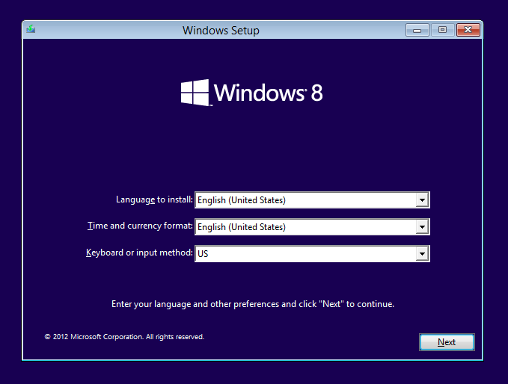

Slide 9
INSTALLING "WINDOWS 8" LOCALLY (continued)
  Step 3: Click on the "Install now" button:

Slide 10
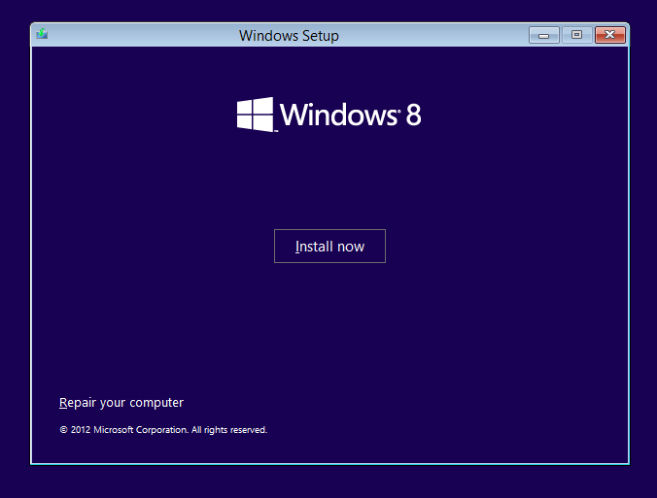

Slide 11
INSTALLING "WINDOWS 8" LOCALLY (continued)
  Step 4: The installation process will run by itself for a while:

Slide 12
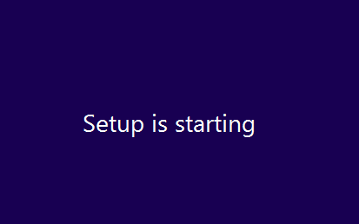

Slide 13
INSTALLING "WINDOWS 8" LOCALLY (continued)
  Step 5: Use the vertical scroll bar to scroll downward to read the license terms.

Slide 14
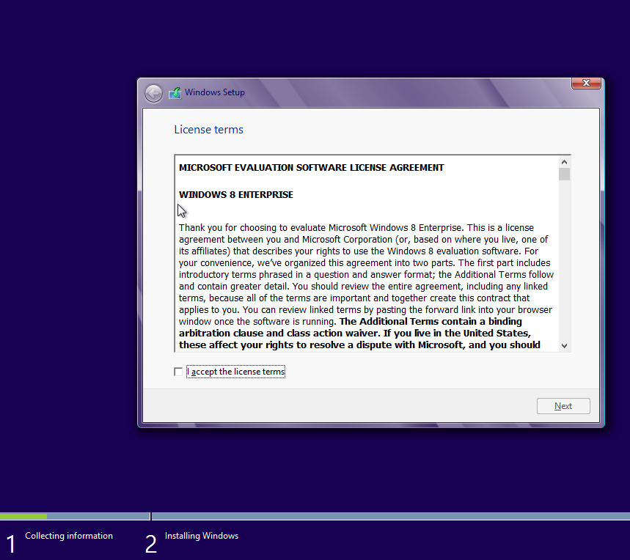

Slide 15
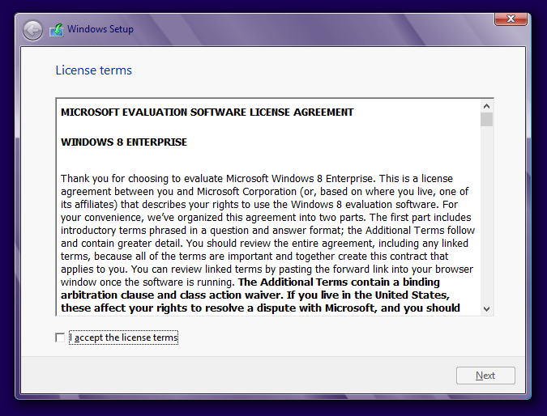

Slide 16
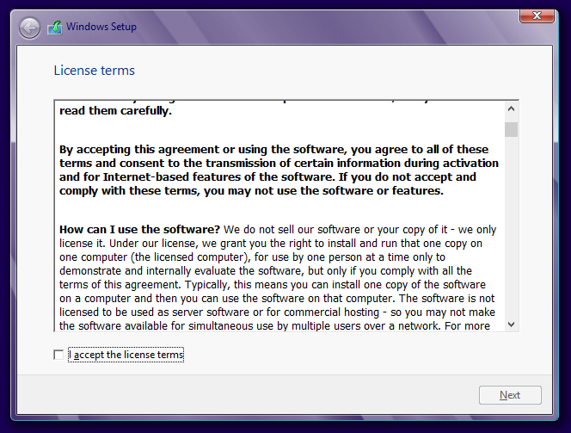

Slide 17
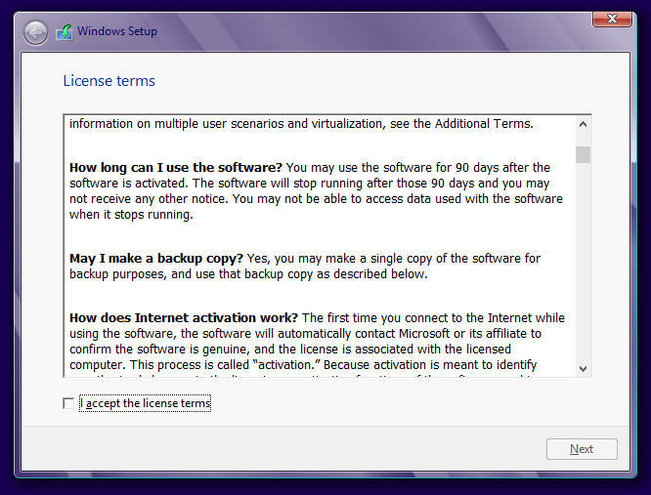

Slide 18
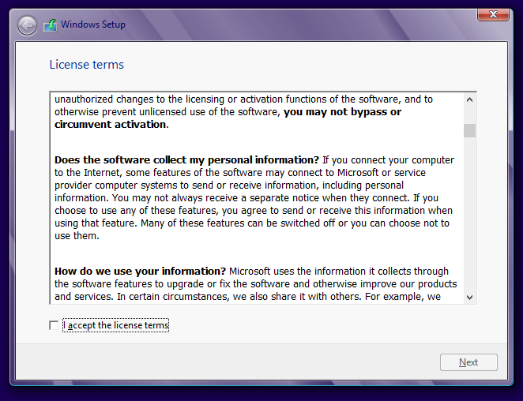

Slide 19
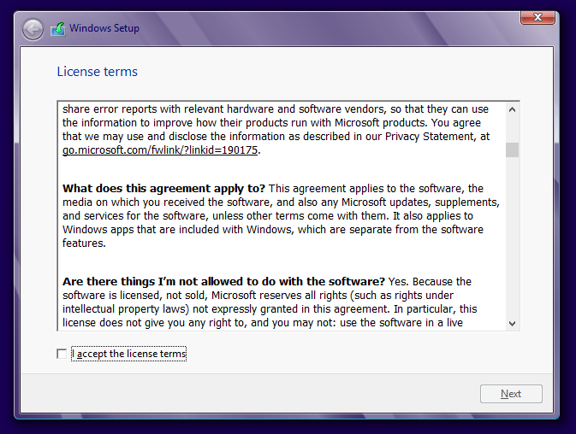

Slide 20
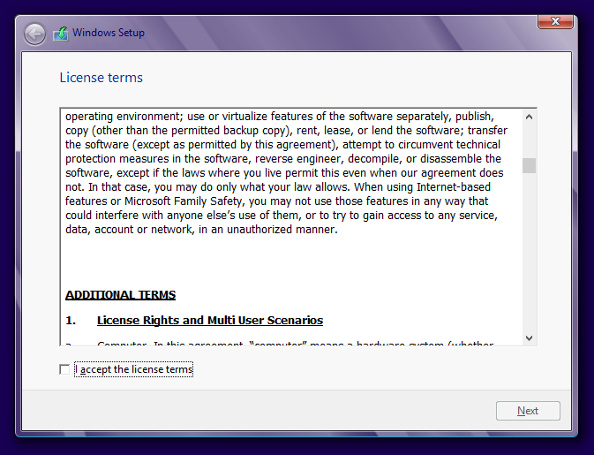

Slide 21
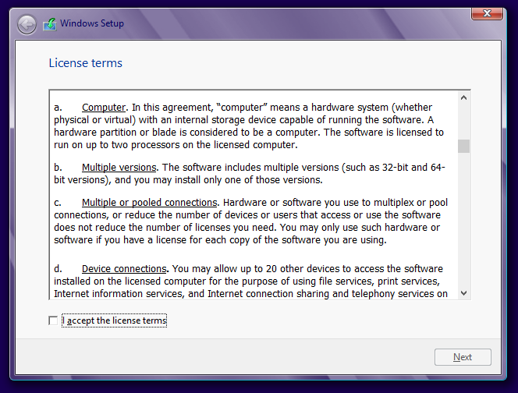

Slide 22
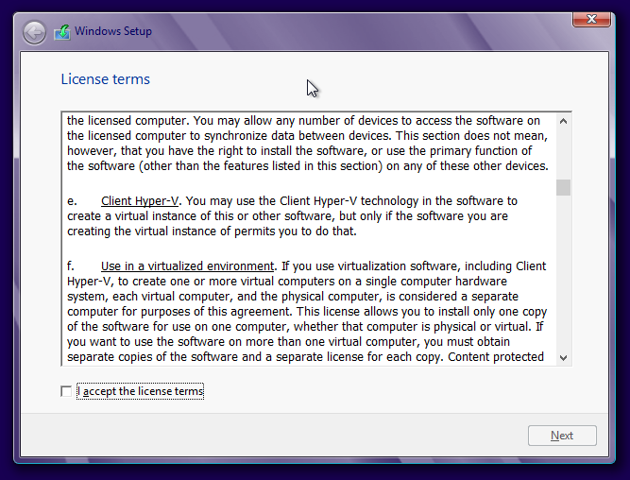

Slide 23
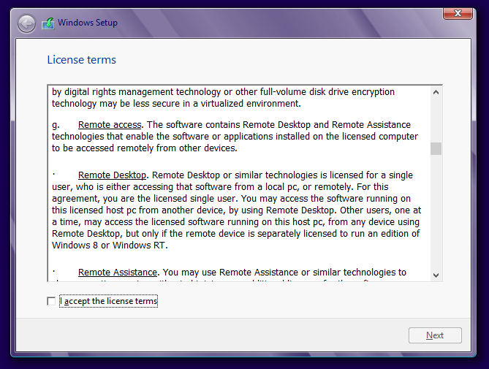

Slide 24
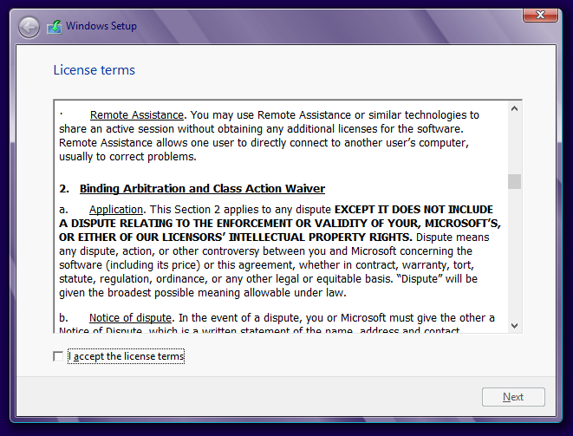

Slide 25
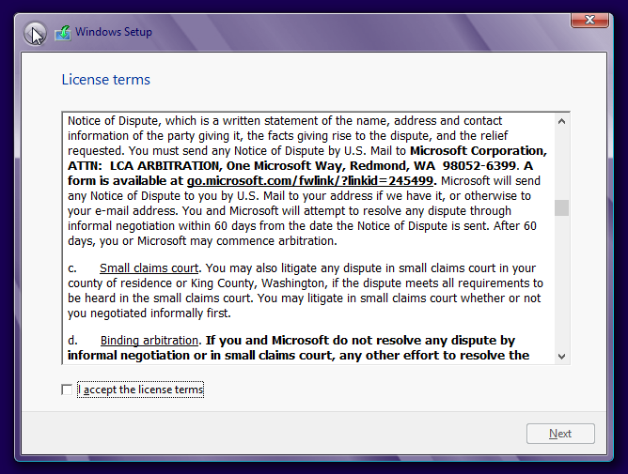

Slide 26
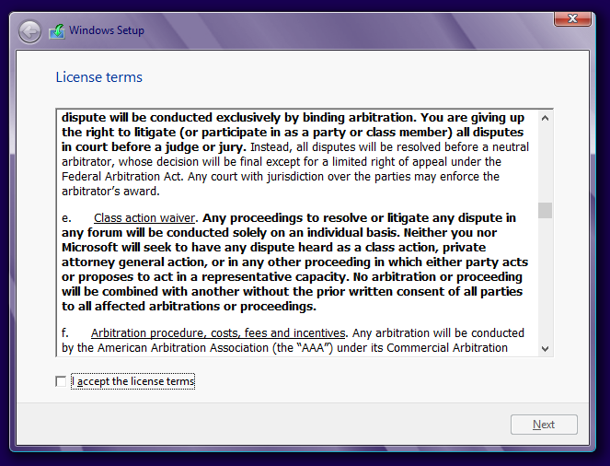

Slide 27
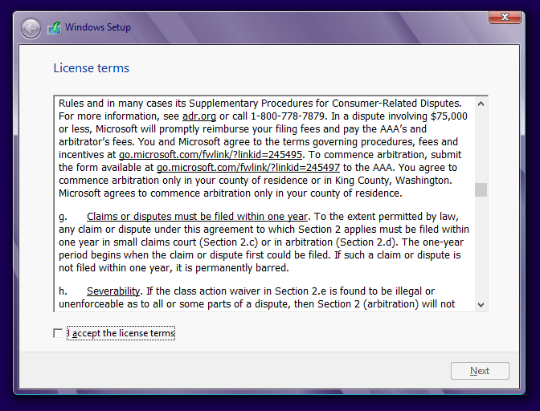

Slide 28
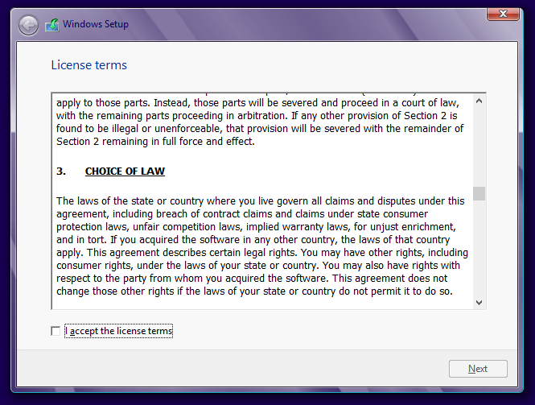

Slide 29
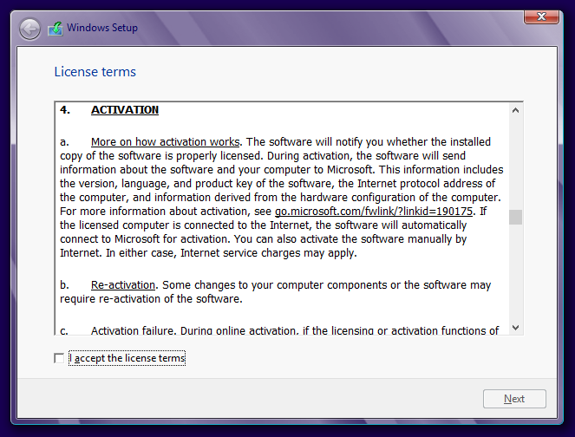

Slide 30
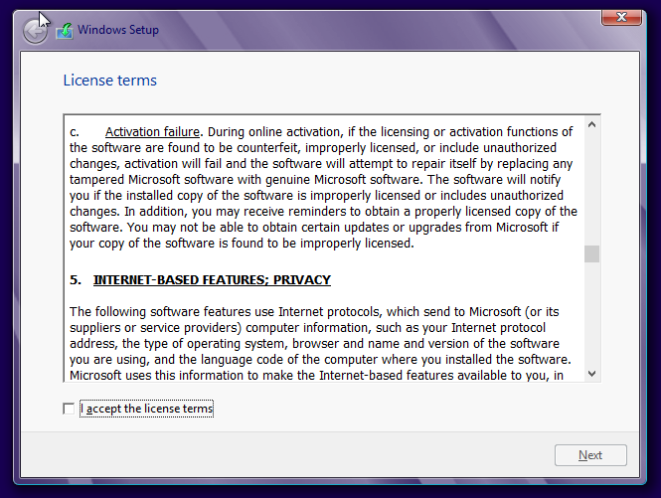

Slide 31
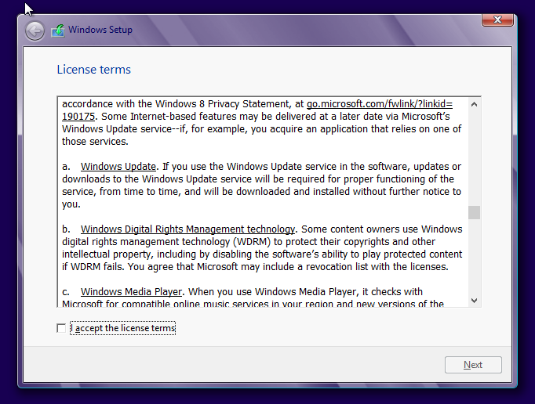

Slide 32
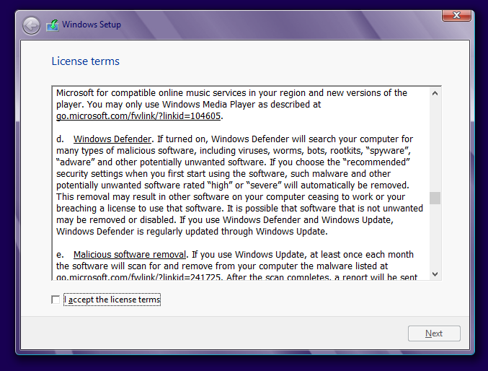

Slide 33
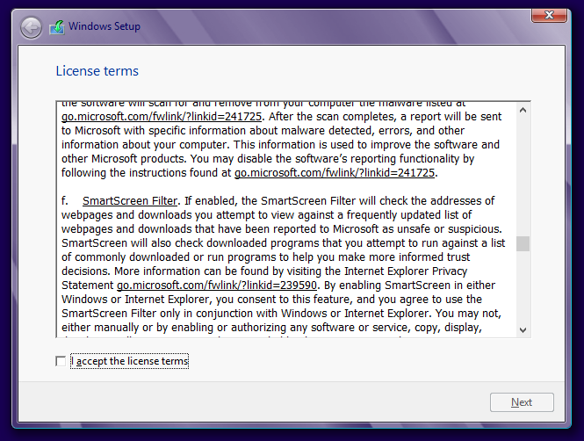

Slide 34
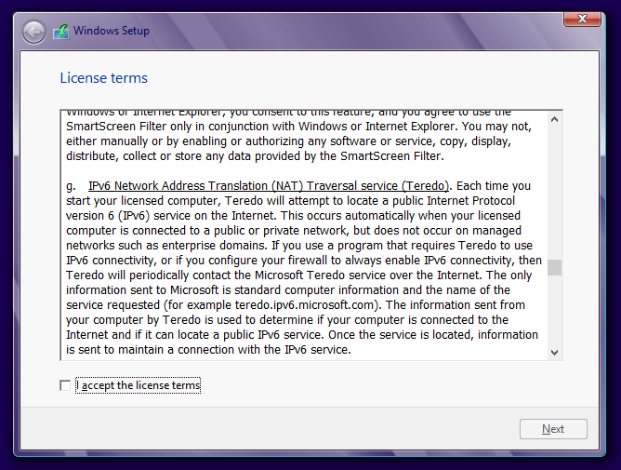

Slide 35
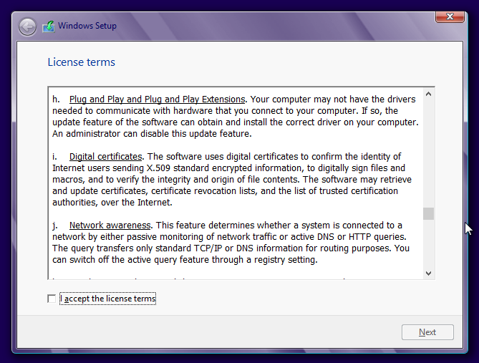

Slide 36
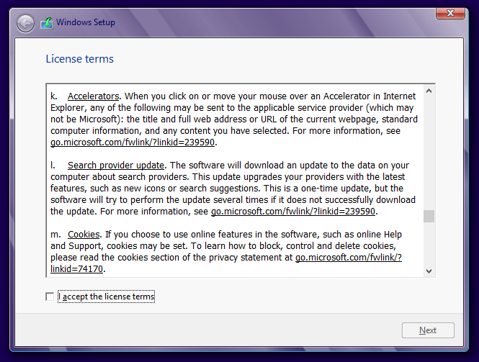

Slide 37
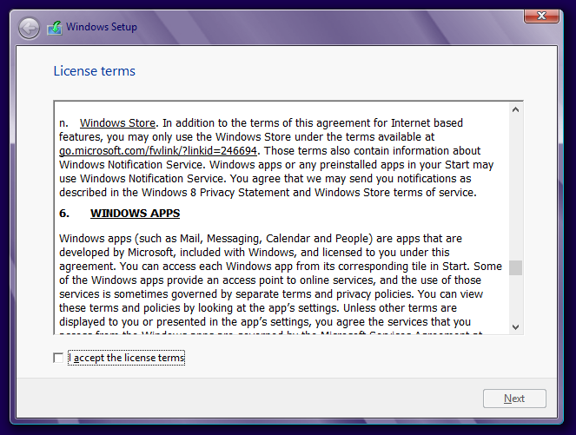

Slide 38
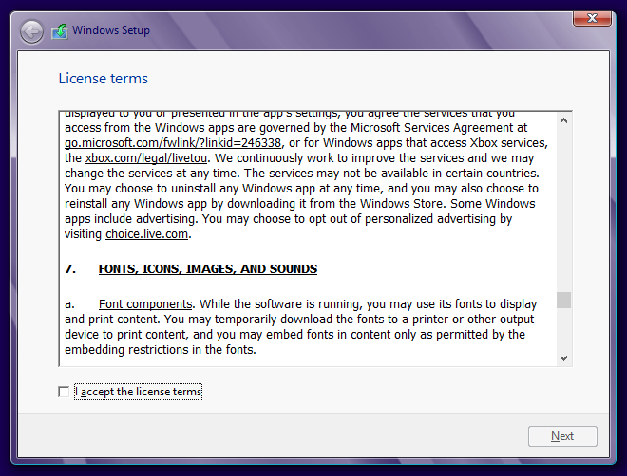

Slide 39
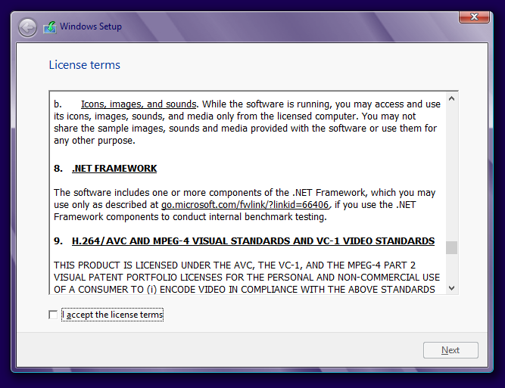

Slide 40
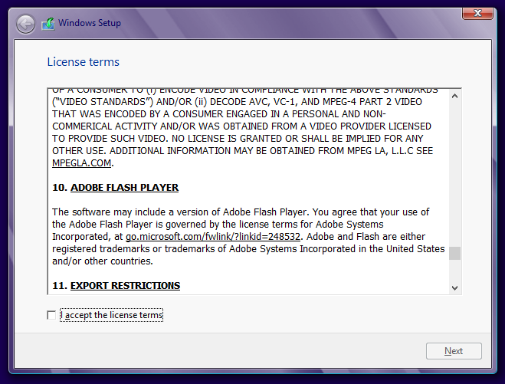

Slide 41
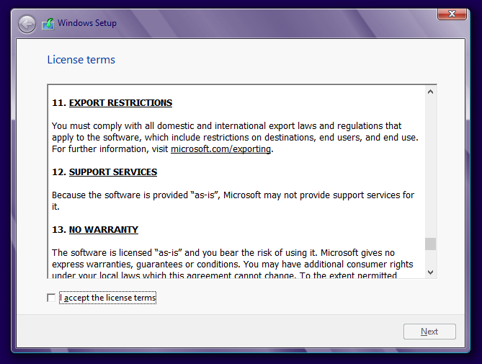

Slide 42
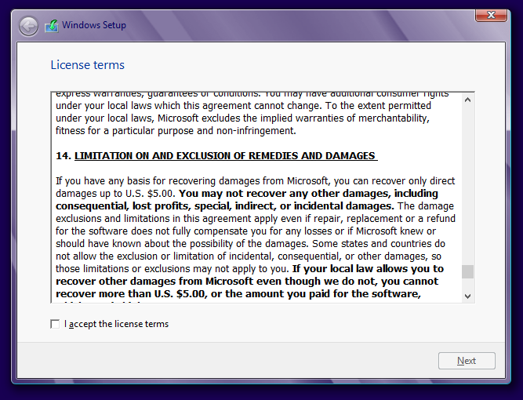

Slide 43
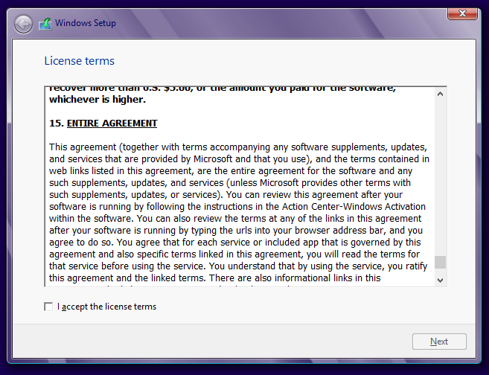

Slide 44
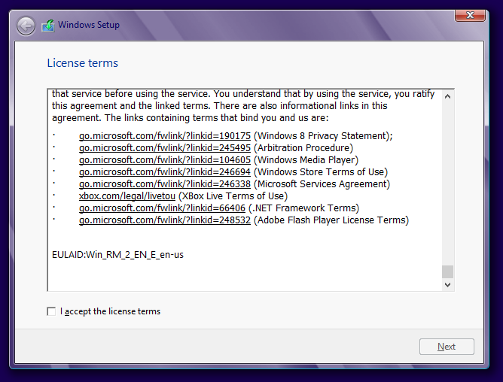

Slide 45
INSTALLING "WINDOWS 8" LOCALLY (continued)
  Step 6: Place a checkmark for "I accept the license terms"

Slide 46
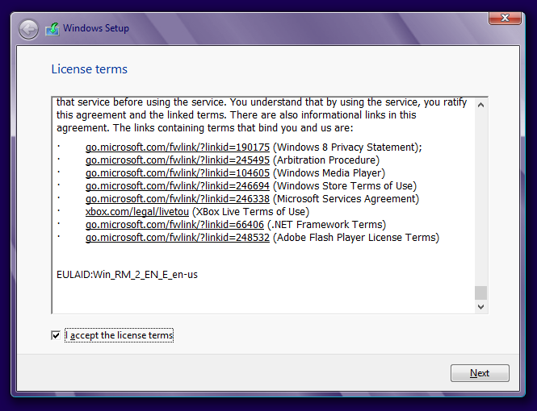

Slide 47
INSTALLING "WINDOWS 8" LOCALLY (continued)
  Step 7: Click on the "Next" button:

Slide 49
INSTALLING "WINDOWS 8" LOCALLY (continued)
  Step 8: Read the descriptions of the "Upgrade" installation and the "Custom" installation and click on the desired type of installation. If you are installing the "Windows 8 Enterprise Evaluation", you should click on "Upgrade" installation only if you have existing data files and application programs that you want moved to "Windows 8.."

Slide 50
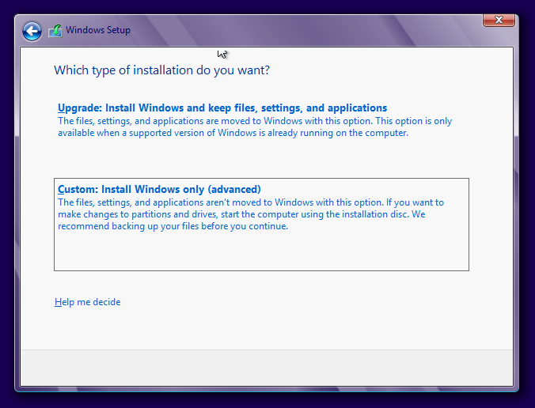

Slide 51
INSTALLING "WINDOWS 8" LOCALLY (continued)
  Step 9: This next step lets you select the desired hard drive (if you computer has more than one powered up). It also optionally lets format the target hard drive and/or select the target partition, if the target hard drive has more than one usable NTFS partition. Click on the "Next" button

Slide 52
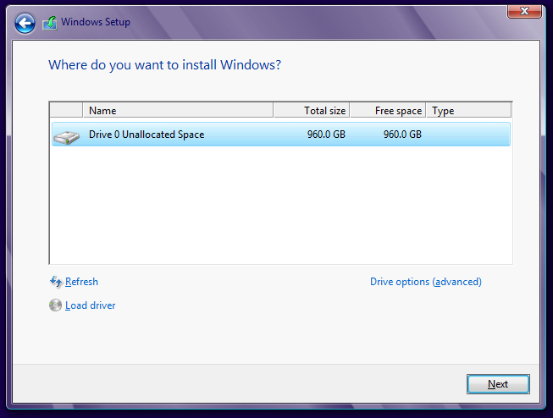

Slide 53
INSTALLING "WINDOWS 8" LOCALLY (continued)
  Step 10: Click on the "Next" button:

Slide 55
INSTALLING "WINDOWS 8" LOCALLY (continued)
  Step 11: The installation process will run by itself for a while:

Slide 56
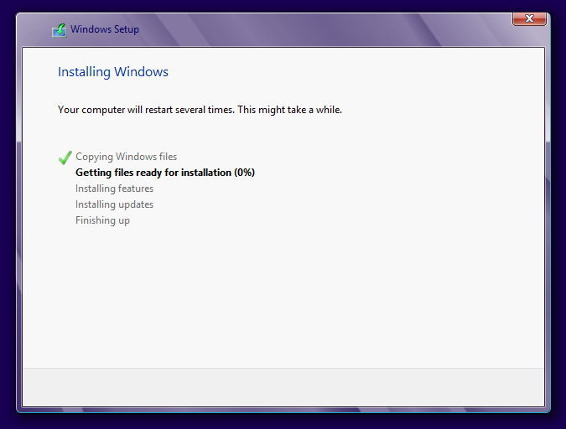

Slide 57
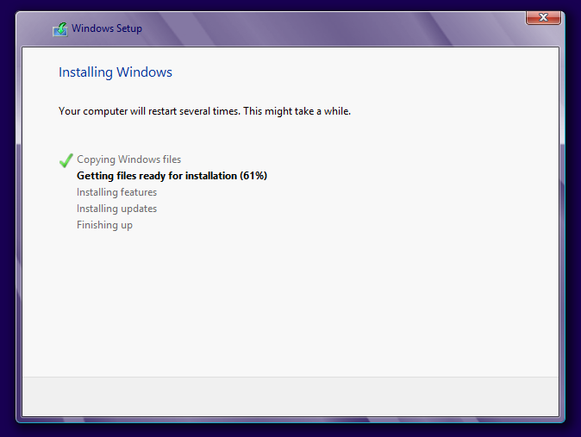

Slide 58
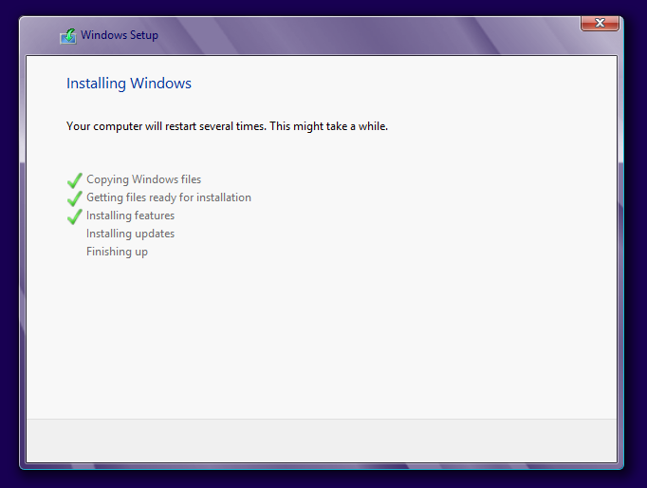

Slide 59


Slide 60
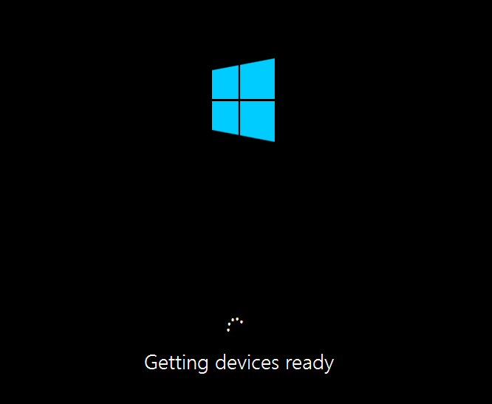

Slide 61
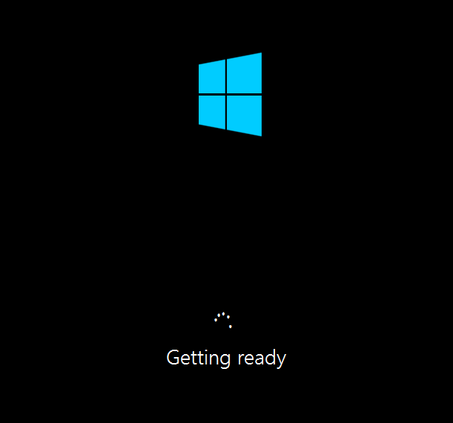

Slide 62


Slide 63
INSTALLING "WINDOWS 8" LOCALLY (continued)
  Step 12: After a reboot or two, your input is needed again:

Slide 64
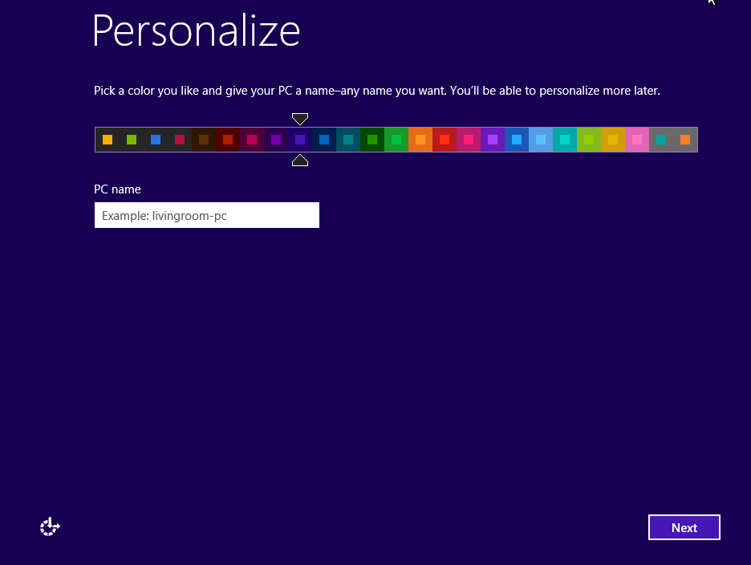

Slide 65
INSTALLING "WINDOWS 8" LOCALLY (continued)
  Step 13: Type in a name for your computer:

Slide 66
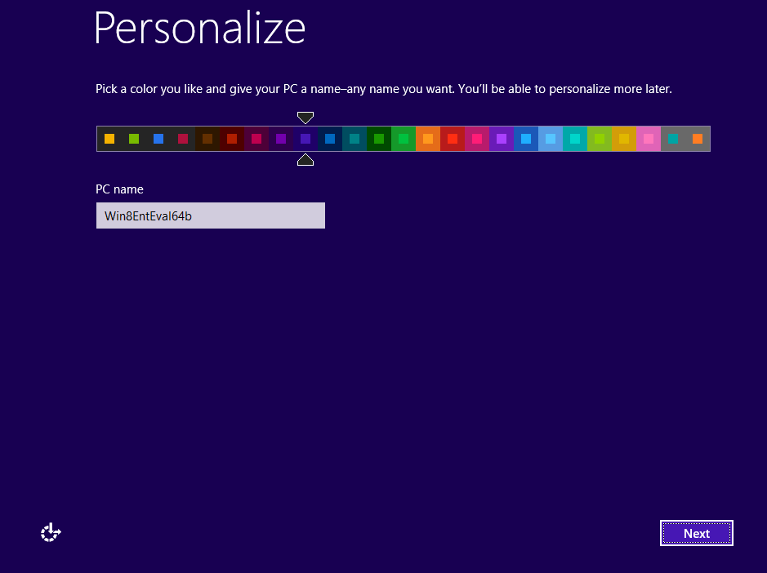

Slide 67
INSTALLING "WINDOWS 8" LOCALLY (continued)
  Step 14: Click on the "Next" button:

Slide 69
INSTALLING "WINDOWS 8" LOCALLY (continued)
  Step 15: Click on the "Customize" button:

Slide 70
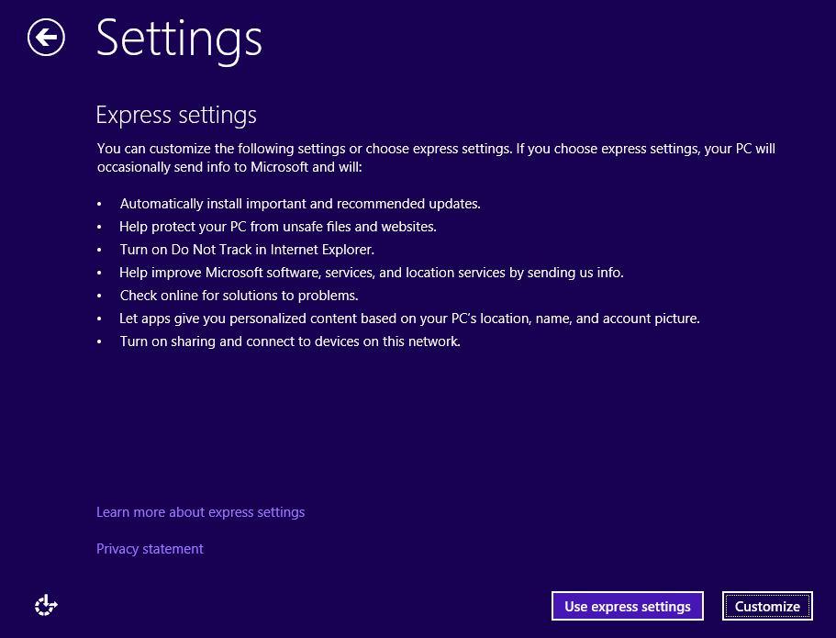

Slide 71
INSTALLING "WINDOWS 8" LOCALLY (continued)
  Step 16: Click on "Yes, turn on sharing and connect to devices".

Slide 72
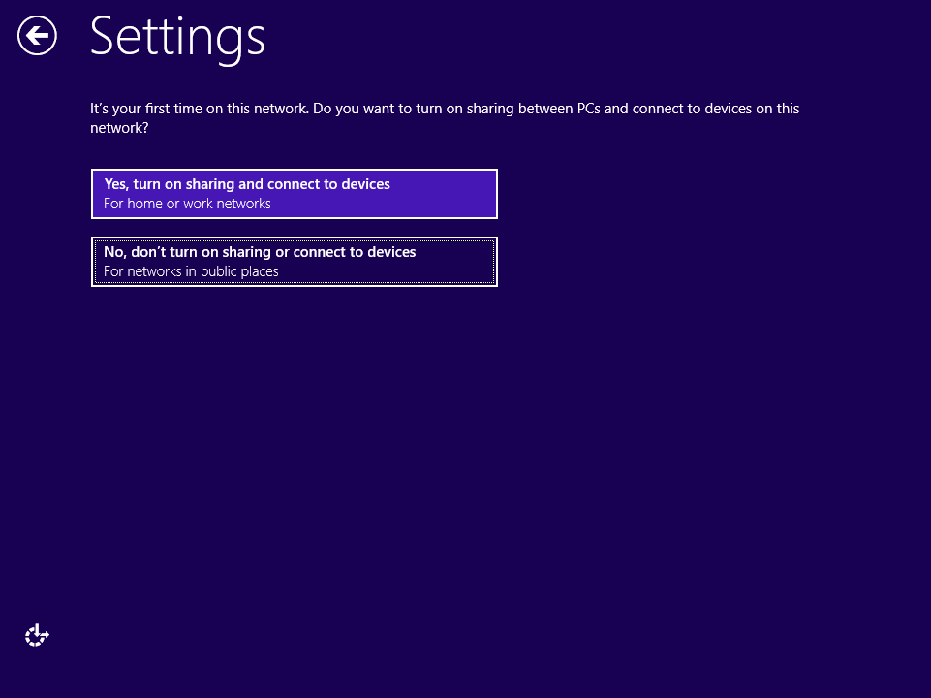

Slide 73
INSTALLING "WINDOWS 8" LOCALLY (continued)
  Step 17: Click on the "Next" button:

Slide 74
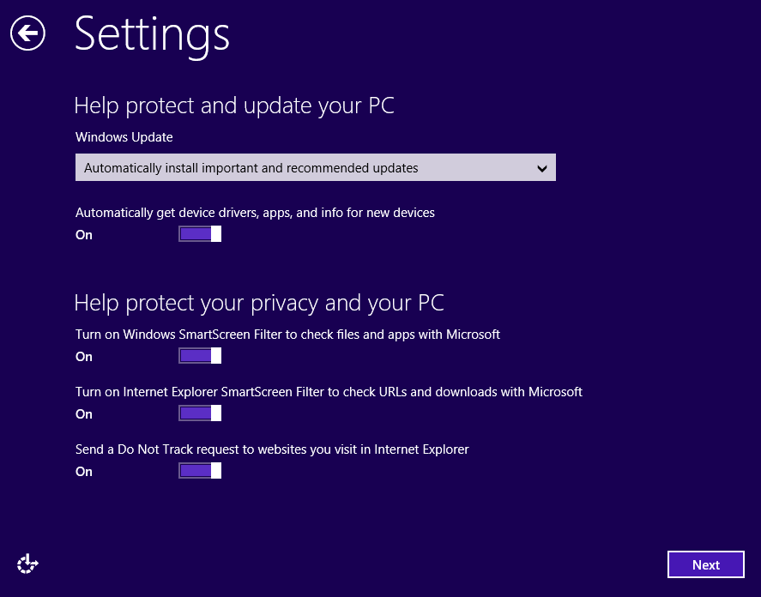

Slide 75
INSTALLING "WINDOWS 8" LOCALLY (continued)
  Step 18: Click on the "Next" button:

Slide 76
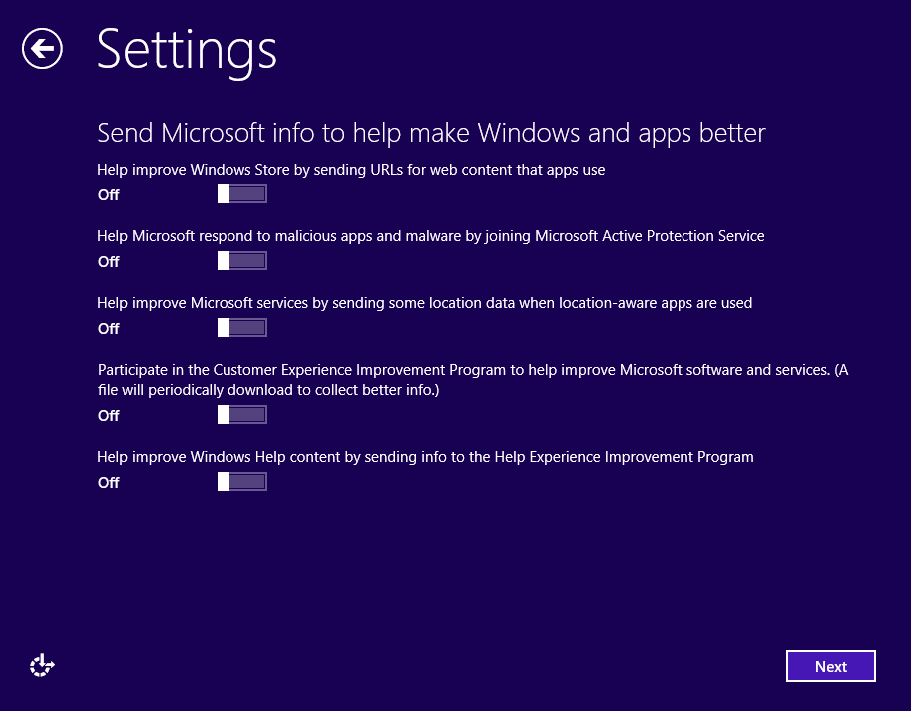

Slide 77
INSTALLING "WINDOWS 8" LOCALLY (continued)
  Step 19: Locate the slider for "Let apps use my name and account picture". Drag the slider to the left so that it is "Off".

Slide 78
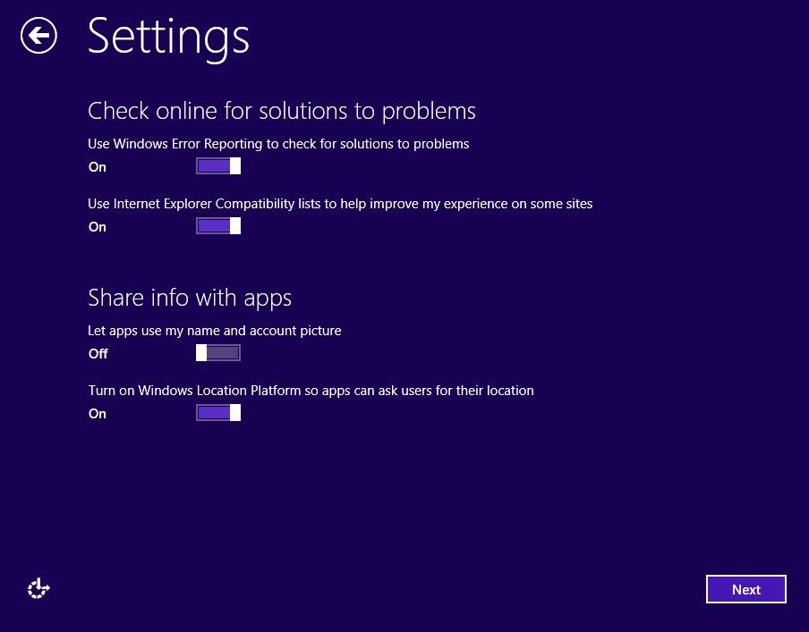

Slide 79
INSTALLING "WINDOWS 8" LOCALLY (continued)
  Step 20: Locate the slider for "Turn on Windows Location Platform so apps can ask users for their location". Drag the slider to the left so that it is "Off".

Slide 80
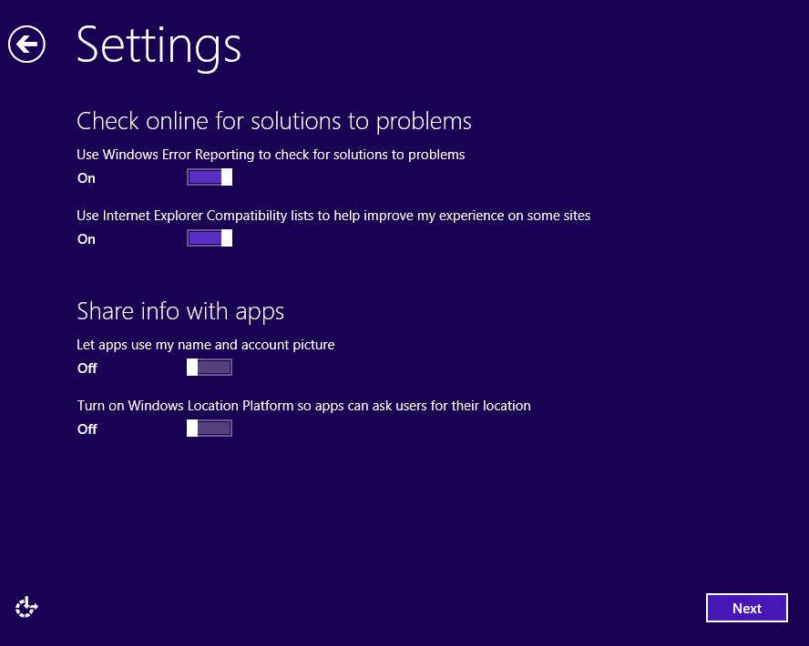

Slide 81
INSTALLING "WINDOWS 8" LOCALLY (continued)
  Step 21: Click on the "Next" button:

Slide 83
INSTALLING "WINDOWS 8" LOCALLY (continued)
  Step 22: Click on "Sign in without a Microsoft account":

Slide 84


Slide 85
INSTALLING "WINDOWS 8" LOCALLY (continued)
  Step 24: Click on "Local account":

Slide 86


Slide 87
INSTALLING "WINDOWS 8" LOCALLY (continued)
  Step 25: Type in a User name:

Slide 88


Slide 89


Slide 90
INSTALLING "WINDOWS 8" LOCALLY (continued)
  Step 26: Type in a password:
  (Be sure to write down the password somewhere.)

Slide 91


Slide 92
INSTALLING "WINDOWS 8" LOCALLY (continued)
  Step 27: Type in the same password in the "Reenter password" field:

Slide 93


Slide 94
INSTALLING "WINDOWS 8" LOCALLY (continued)
  Step 28: Type in a "Password hint":

Slide 95


Slide 96
INSTALLING "WINDOWS 8" LOCALLY (continued)
  Step 29: Click on the "Finish" button:

Slide 98
INSTALLING "WINDOWS 8" LOCALLY (continued)
  Step 30: The monitor screen will display some informative animations for a while:

Slide 99


Slide 100
INSTALLING "WINDOWS 8" LOCALLY (continued)
  Step 31: The "Start" screen of "Windows 8" will be displayed for you to use:

Slide 101


